Slide 1
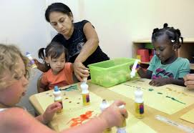


Early Childhood Educator Preparation Program Innovation (EPPI) Grants
Implementation Study FINDINGS
2014-2015
Notes:
Stephanie

Slide 2


Overview of Presentation
Early Childhood Landscape
ECE project
Early Implementation Study
  Methods
  Themes
  Partnership development theory
Promising Practices Specific to Transfer and Articulation
Notes:
Stephanie

Slide 3
Early Childhood Landscape
EC education and preparation is extremely complex.
  ECE is inclusive of a wide array of roles and responsibilities.
  There are multiple degree, licensing, and/or credentialing requirements from one or more agencies
  There are numerous entry points into the early childhood workforce that result in a wide-range of jobs.
These complexities impact HE institutions.
  HE programs must address the myriad of state and national professional standards and licensing requirements.
Although HE institutions do a large share of the ECE preparation, EC employers also prepare and develop ECE teachers.
  Some ECE teachers start their formal training when they become employed in the field.
An increase in educational requirements (e.g., Head Start) necessitates ECE teachers receive postsecondary education.
Notes:
Stephanie
Maybe use this condensed one rather than the 2 previous slides
- There is a high degree of complexity regarding early childhood education itself, as well as in the preparation of early childhood teachers.
- ECE is inclusive of a wide array of roles and responsibilities.
- There are multiple degree, licensing, and/or credentialing requirements from one or more agencies
- There are numerous entry points into the early childhood workforce that result in a wide-range of jobs.
- Institutions of higher education preparing EC educators are impacted by these complexities in that they must design programs that address the myriad state and national professional standards and licensing requirements
- Although higher education institutions do a large share of the ECE preparation, the development of EC teachers does not rest solely with them.
- The preparation and development of EC teachers includes the various entities for whom they work.
- Some ECE teachers do not participate in pre-service education -their formal training as ECE teachers might not start until they are employed in the field.
- There has been an increase in educational requirements in programs such as Head Start, which necessitates attending a college or university.

Slide 4
Goals of the EPPI Grant Initiative
Develop models of effective early childhood educator preparation
Foster partnership development between two- and four-year preparation programs and other community-based organizations
Promote articulation
Incorporate Gateways entitlement
Support ECE programs is designing curriculum to incorporate new program requirements
Build capacity in key areas of need (e.g., Bilingual/ESL, early math learning, special education)
Create opportunities for innovation program implementation
Notes:
Stephanie

Slide 5
2014-2015 Grant Process
Partners included OECD, The Center: Resources for Teaching and Learning, IBHE, ISBE, ICCB, HELP, and others
First Round – 2014-2015
  Applications from institutions across sectors and all regions of the state
  Grantees include 35 institutions engaged in partnership – 12 public and private universities and 23 community colleges
  $545,000 in awards from RTT ELC funds – ranging from $39,000 to $48,000
  February 2014 through January 2015
Notes:
Stephanie

Slide 6
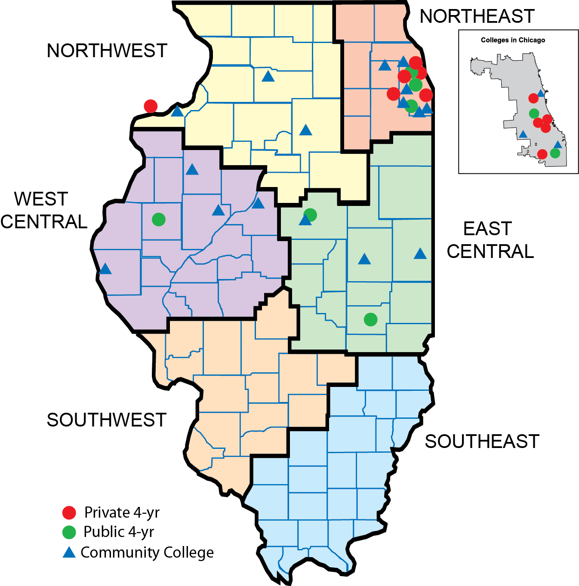
2014-2015
EPPI Grant Partnerships
  35 institutions from across the state
  12 public and private universities
  23 community colleges
Notes:
Stephanie
Either delete or cover very quickly due to time constraints

Slide 7
Purposes of the
Early Implementation Study
Examine the initial implementation of proposed grant activities
Identify barriers
Identify catalysts
Consider sustainability of the grants’ impact
Notes:
Brenda

Slide 8
IERC Methodology
Systematically reviewed proposal narratives for each project
Developed interview protocol
Conducted the interviews
Coded responses
Analyzed responses for overarching themes and sub-topics as well as their relationship to partnership development theory (McQuaid, 2009)
Notes:
Brenda

Slide 9
Interview Questions
Focused on major goals and activities associated with each project
  Barriers to implementation
  Catalysts and levers allowing for implementation
  Innovations and enhancements to articulation
  Program/curricular enhancements
  Real and potential impacts
Partners’ progress in the implementation process
Ways in which new standards and program requirements were being met
  Articulation
  Overall
Overall thoughts about the grant process
Notes:
Brenda

Slide 10
Motivations for Grant Participation
Improve articulation
Build partnerships and networks
Increase degree completion of transferring students
Four-year partners: Increase transfer student recruitment and diversity of ECE students
Meet students’ needs
  Smooth transition to decrease credit loss and increase affordability
  Provide support to pass the Test of Academic Proficiency
  Create opportunities to provide secondary ESL endorsements
  Develop support structures to help students succeed after their transfer
  Increase marketability among graduates
Notes:
Brenda or Eric
Condensed version of 2 previous slides
Maybe delete or highlight 1 or 2 if time is tight.
Improve articulation between community colleges and four-year institutions
Build partnerships and networks among community colleges and four-year programs
Four-year partners also discussed the potential for increased recruitment of transfer students, as well as an increase in diversity of their early childhood students.
Increasing degree completion of transferring students as a desired outcome of the collaborations and grant activities.
Meeting students’ needs
Ensuring a smooth transition to decrease credit loss and increase affordability for students
Providing support to pass the Test of Academic Proficiency
Creating opportunities to provide secondary ESL endorsements
Developing support structures to help students succeed after the transfer
Increasing marketability among graduates

Slide 11
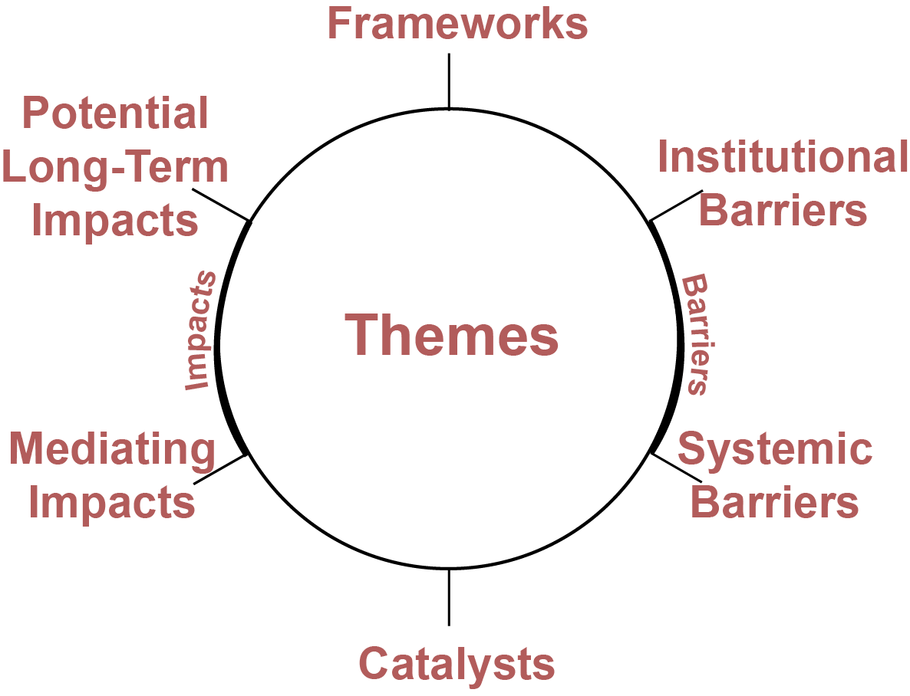
Coding Structure for Responses
Guided by interview protocol
Overarching goals of the implementation project
Each theme had between two and six sub-topics.
Notes:
Eric

Slide 12
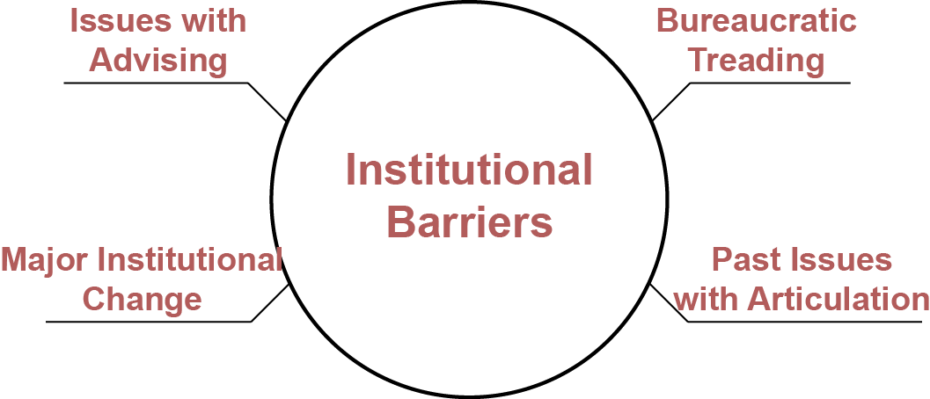
Institutional Barriers
Institution or partnership specific
Preventing goal attainment and/or partnership development
Most were historical in nature
Often wedded with a catalyst
Notes:
Eric

Slide 13
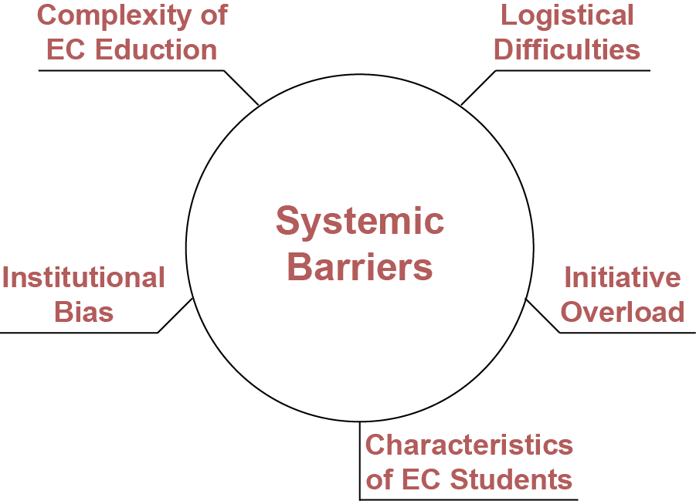
Systemic Barriers
Global/ common among multiple partnerships
Defined the challenging contexts in which the partnerships were operating
Particularly, the contexts that impede timely goal attainment
Notes:
Eric

Slide 14
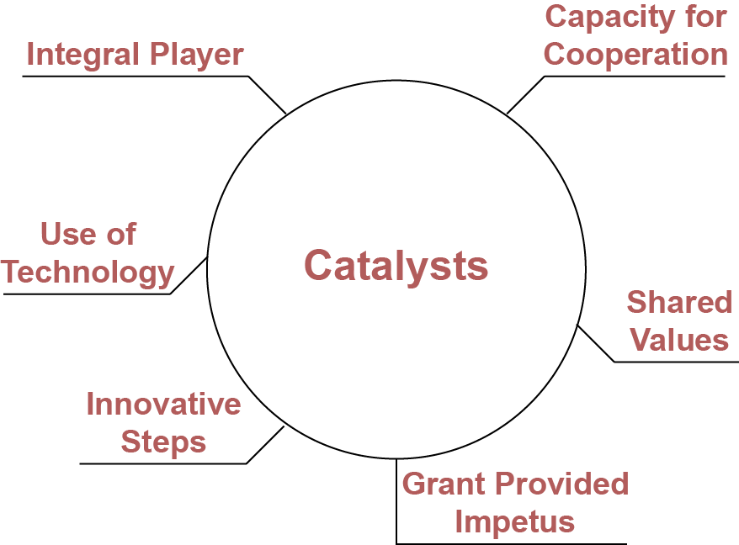
Catalysts
Provided movement towards goal attainment
Many adopted from McQuaid’s (2009)
Often a response or reaction to a historical or contextual barrier
Notes:
Eric

Slide 15
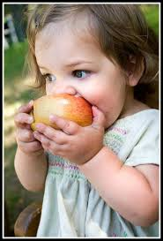
Catalysts
Shared Values- “Previously these discussions have been an institutional focus, now they are focused around the students.”
Capacity for Cooperation- “The opportunity to meet face to face was great. Communicating with them via email is one thing, but gaining an understanding of them as people and knowing their teaching styles was extremely beneficial.”
Grant Provided Impetus-“ The grant was the ‘dike’ to hold off other responsibilities/commitments for a short time to focus on grant activities.”
Notes:
Eric
- Maybe use just one quote

Slide 16
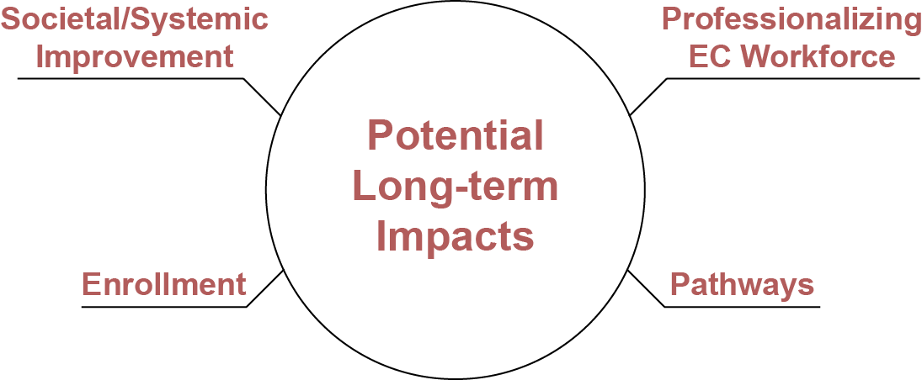
Potential Long-Term Impacts
Overarching
Could not be measured in the timeframe of the grant
Notes:
Eric
Add a quote

Slide 17
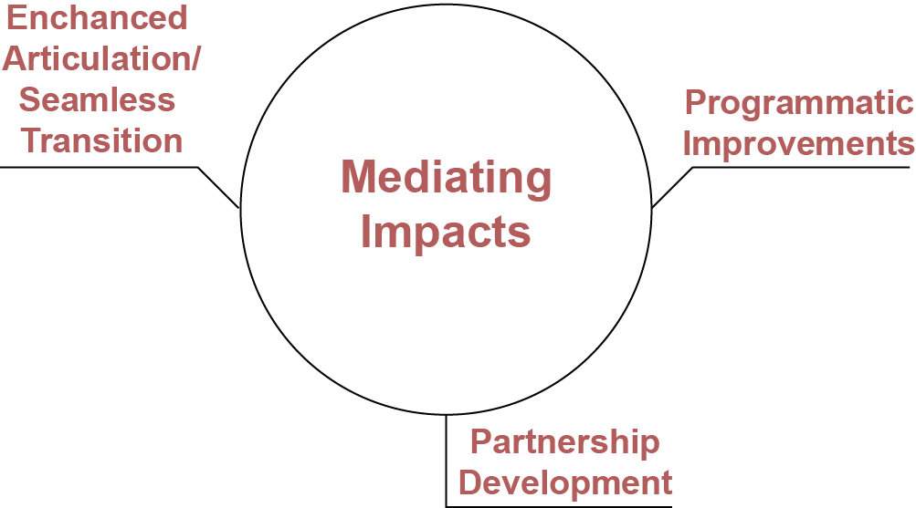
Mediating Impacts
Already budding, direct result from grant
Precursory in nature
Framework for
long-term impacts
Notes:
Eric
- Add a quote

Slide 18
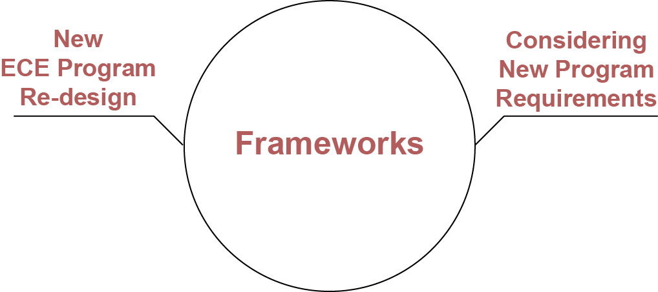
Frameworks
Neutral references to new program requirements and standards
Notes:
Eric
Probably could skip the quote

Slide 19
Views of the EPPI Grant Process
Almost exclusively positive
  “Grant opportunities like these push us to do this difficult work that we would not have done otherwise.”
  Often wondered if it would all lead to the end goal of reaching the students. But it did…It was incredibly worthwhile to go through the whole process.”
Cataylst for new dialogue and conversation
  “The grant has allowed for a bigger conversation of the education system as a whole and has allowed for institutions to realize how similar they are.”
Overall the structure and support were beneficial, probably more so than the money
  “The grant provided the structure and support necessary to accomplish the goals and move from talk and discussion to action.”
Notes:
Eric
Nice slide…probably just pick 1 to read to audience

Slide 20
Major Findings
Most of the partnerships were moving towards achieving their grant-related goals.
The grants had a fairly large positive impact, particularly in terms of:
  partnership development;
  enhancing articulation pathways between the partners;
  integration of the Gateways Credentials into programs and into the transfer process.
Some of the themes and sub-topics identified from the interview responses were mirrored key ideas within partnership development theory, as described by McQuaid (2009).
Identified barriers were often wedded to a catalyst
Notes:
Eric

Slide 21
Ideas for Enhancing Partnerships
Frame discussions and goals using a student-centric approach.
Include necessary players at the table.
Rotate meeting sites, at times hold meetings in informal settings.
Integrate community-based entities into the partnership.
Increase within-institution communication
Use technology to supplement traditional face-to-face meetings and enhance the flow of information between partners.
Notes:
Stephanie

Slide 22
Promising Innovations
Regional consortium
Cross- and intrusive advising
Building several bridges for transfer candidates
Full articulation and early commitment to the field
Non-licensure baccalaureate programs
Early math learning micro-teaching modules
Notes:
Stephanie
Building a Cultural Bridge
Related to Tinto’s (1987) Theory of Integration
Creating an environment that allows for a psychological and social attachment to be formed
Transfer shock
Create opportunities for transfer students to be active in both institutions during their first two years to ease the transition
Cross-Advising
Sound advising practices mediate the influence of formalized articulation
It serves as an academic, advising, and cultural bridge
Best practices identified by Karp (2014) and Council of Independent Colleges (2014)
High-touch services
How to bring such advising practices to scale and establish their cost effectiveness?
Non-licensure Baccaulaureate Programs
Developing such highly structured transfer was a common goal with the overwhelming majority of the partnerships.
Specificity is the key to such agreements, in terms of the sending and receiving institutions, the majors, and articulated courses.
Slight deviations from the plan or uncertainty about a major at the beginning of one’s college career might necessitate additional time to degree completion.
We argue that more must be done to get community college students potentially interested in ECE to commit to that major earlier in their academic career.
Dual-credit could be one option

Slide 23
For More Information
IERC
IBHE
Brenda Klostermann
breklos@siue.edu
http://ierc.education
The Early Childhood Educator Preparation Program Innovation Grant: Lessons from Initial Implementation
  (Lichtenberger, Klostermann &Duffy, 2015)
http://ierc.education/our-research/publications/
Stephanie Bernoteit
bernoteit@ibhe.org
Notes:
Stephanie

